Slide 1
1. My name is Josée Boulanger, I have long reddish wavy hair, I am wearing glasses and I use the pronouns she-her. I am a PhD candidate at the School of Rehabilitation Sciences at the University of Ottawa and much of my work has been inspired by my younger brother Stéphane who was labelled as having an intellectual disability and who loved to connect with people and used whatever techniques necessary to communicate with people. Today I am talking to you from Rockland, Ontario, a small town east of Ottawa located within the unceded unsurrendered Algonquin, Anishinabek territory. If you have any questions about my presentation or ideas for collaborating, you can reach me at josee.boulanger@uottawa.ca I am also happy to share with you any of the material I will soon discuss. I have provided a verbatim transcript of this presentation to the organizers as well as a description of the video vignettes I have chosen to present. Please feel free to get up and move around during my presentation.
Notes:
Introduction
1. My name is Josée Boulanger, I have long reddish wavy hair, I am wearing glasses and I use the pronouns she-her. I am a PhD candidate at the School of Rehabilitation Sciences at the University of Ottawa and much of my work has been inspired by my younger brother Stéphane who was labelled as having an intellectual disability and who loved to connect with people and used whatever techniques necessary to communicate with people. Today I am talking to you from Rockland, Ontario, a small town east of Ottawa located within the unceded unsurrendered Algonquin, Anishinabek territory. If you have any questions about my presentation or ideas for collaborating, you can reach me at josee.boulanger@uottawa.ca I am also happy to share with you any of the material I will soon discuss. I have provided a verbatim transcript of this presentation to the organizers as well as a description of the video vignettes I have chosen to present. Please feel free to get up and move around during my presentation.

Slide 2
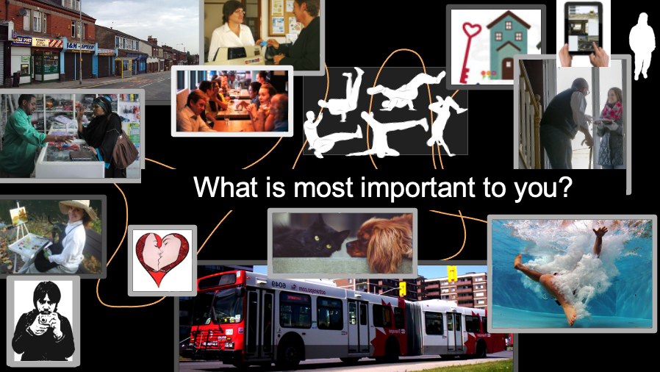
2. Using audio/visual methods to explore a good life
with people labelled with an intellectual disability
Notes:
The title of my presentation is Using audio/visual methods to explore a good life with people labelled with an intellectual disability.
For my doctoral research, I wanted to learn about a good life from people labelled with an intellectual disability who faced significant barriers to communication. I also wanted to learn about and document what could facilitate their participation in research.

Slide 3
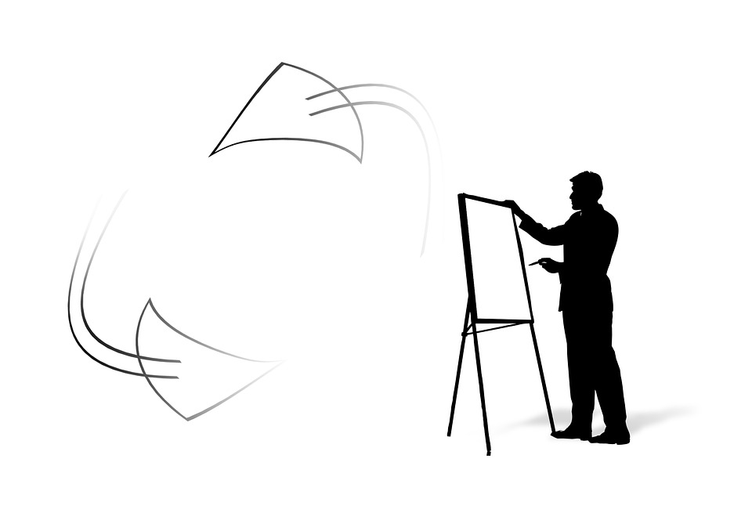
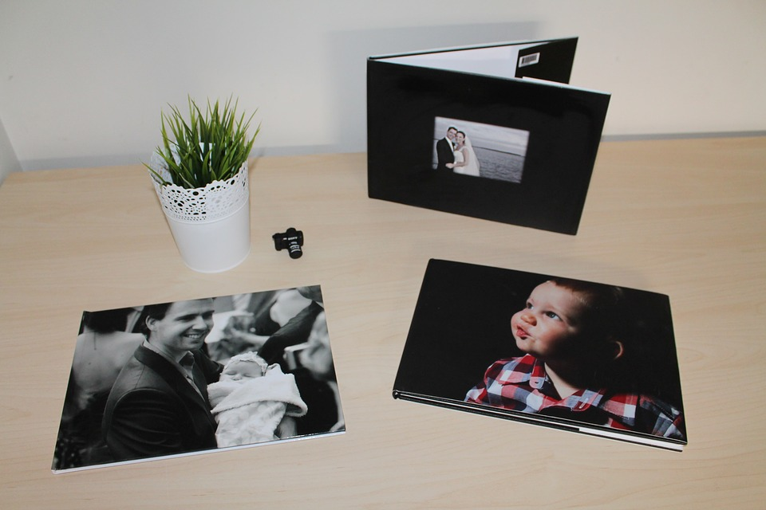



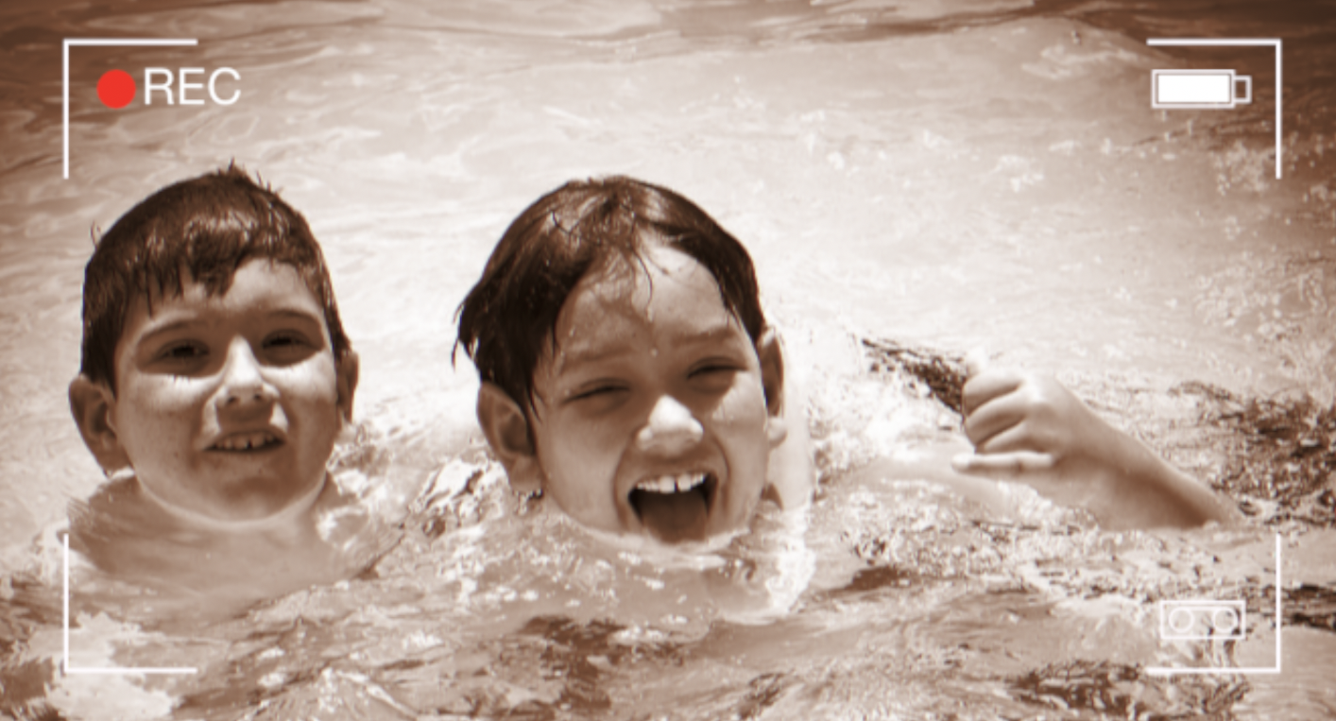
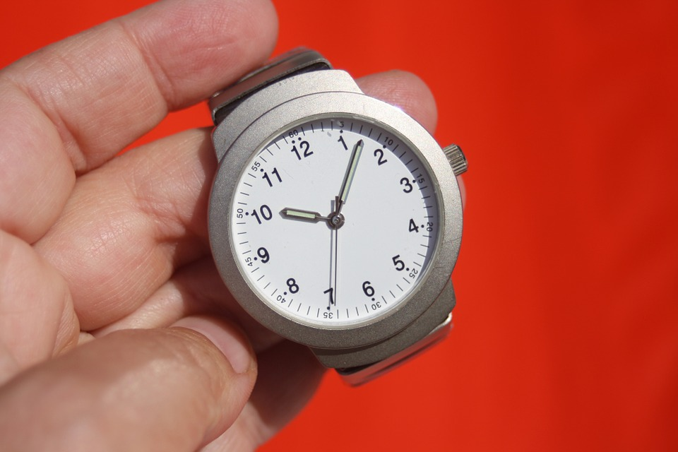

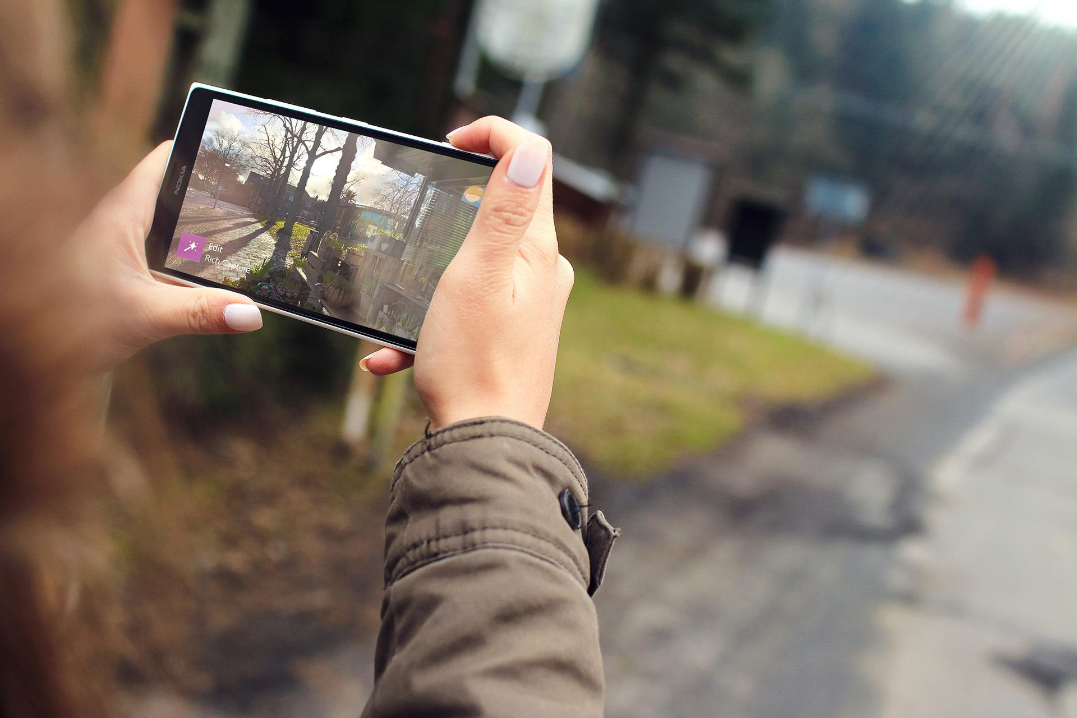
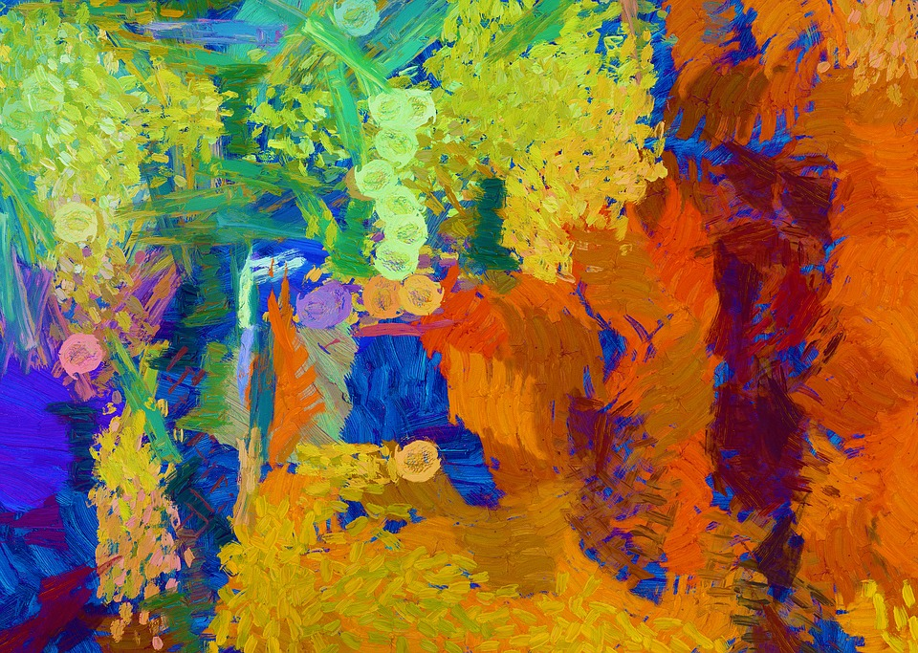
3. Dissertation by articles: 3 studies
2
1
3
Exploring a good life
from the perspectives
of PLWID using
audio/visual methods
Exploring conditions for meaningful participation in research
Narratives of intellectual disability advocacy in Ontario
x
Notes:
As part of my PhD studies, I did a dissertation by articles with 3 small studies.
To learn about what is important for a good life, I decided to look back at advocacy efforts of the past. What had been the focus?
I read old news articles, legal documents and academic and community-based publications. I conducted a focus group with mothers who had been active in advocacy for over 30 years. Through advocacy events like the People First movement, Justin Clark's fight to leave the Rideau Regional Centre, The Eve Decision regarding forced sterilization, Ontario's short-lived Advocacy Act, 1992, the struggle for supported decision-making and the participation of family members and self-advocates in the Partnership Table during the Transformation process of Developmental Services, I noticed three recurring themes:
the fight for autonomy and to make one’s own decisions
the necessity for supports to exercise autonomy
the importance of direct participation of people labelled with an intellectual or developmental disability in policymaking.
Silvers and Francis (2009) argue that the need for direct human support to think about and to communicate ideas should be recognized as a legitimate way of arriving at an opinion or making a decision since everyone, regardless of their abilities makes decisions in relation to others and in relation to existing ideas.
Then, I thought I should ask people with an intellectual or developmental disability who face significant barriers to communication what they think is important for a good life to see how their ideas might inform practice and policy.

Slide 4
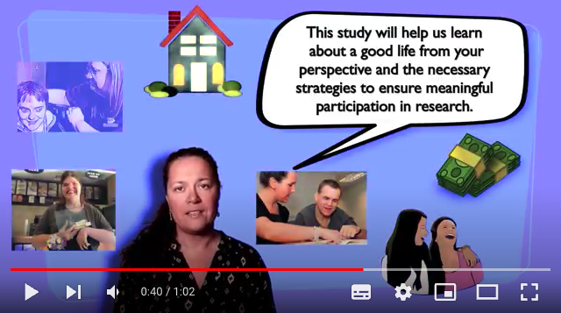
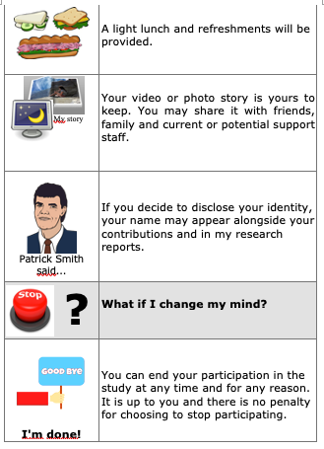
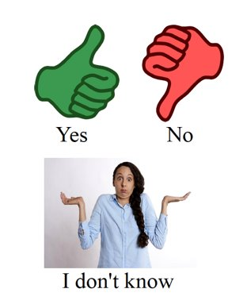
4. Facilitating participation by design
1) Finding participants
2) Consent as process & easy read forms
3) Communication and cognitive supports & strategies.
Notes:
I wanted to learn from people who faced barriers to communication since they were the least represented in advocacy and research. Instead, family members and close staff were often asked to speak for them or to respond for them.
Since my understanding of cognition and communication is informed by a relational perspective, in other words, thinking and communicating happens in relationship with the environment including the abilities, attitudes and beliefs of others, I asked myself “How can I design my study so that people who face significant barriers to communication can actively take part in the research process?''
To find participants, I made short recruitment videos & posters using an easy read format.
I designed my consent forms in easy read format and incorporated a step-by-step approach to consent (Cox et al., 2014).
I made a simple visual tool to facilitate decision-making inspired by Teachman’s (2016) Visual Consent Display.
To further reduce barriers, I offered to help with organizing transportation, taking pictures or video, including visiting locations for the purpose of taking pictures or video. I also had access to video cameras for participants from the Creative Practices Centre at the School of Rehabilitation Sciences.

Slide 5
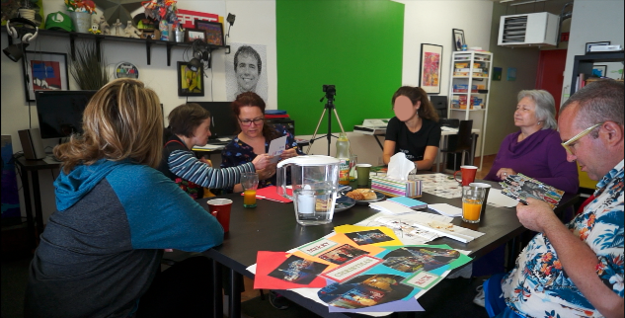
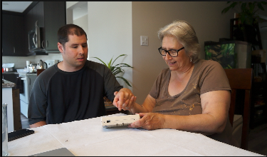
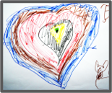



5. Workshops
Individual sessions
Methods used for collecting data:​
Drawing​
Video​
Photography​
Writing​
​
Notes:
To provide options for participants, I decided to conduct group sessions and individual sessions to explore a good life with participants. This way, participants could join the group workshop if they felt comfortable and liked the idea or, they could just take part in the individual sessions if that's what they preferred.
2 women and 3 men from the Ottawa area participated in this study. 2 communicated in English, one was bilingual French and English, the other French and Arabic and another participant communicated in ASL. 9 supporters also took part in the study.
Very broadly, the methods we used to collect data throughout our process were:
○Drawing (storyboard sketches)
○Video (new & old)
○Photography (new & old)
○Writing (new & old)These are video stills of our workshops during which we explored what was part of a good life.
The picture on the left shows us during the first workshop. I asked participants to bring photographs and objects that were meaningful to them and to share them with the group. This marked the beginning of our exploration.
The picture on the right shows an individual session with Philippe and his mother who is supporting him to type. Based on pictures and video Philippe had chosen with his mother, I then asked him to tell me why it was important or what he liked about it.

Slide 6
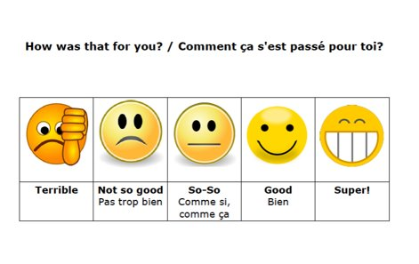

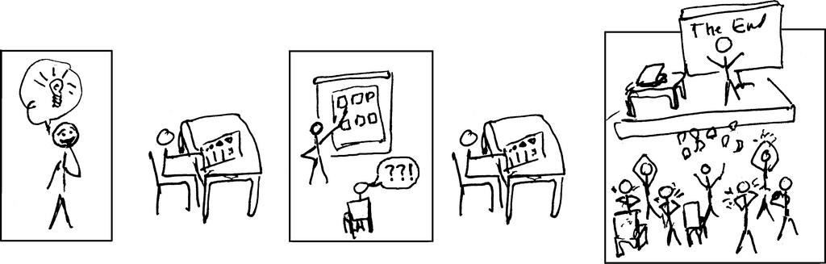

6. Communication and cognitive strategies
So, the best part was travelling with your best friend?
Incorporating Augmentative and alternative communication (AAC), Supported Conversation with Adults with Aphasia (SCATM) and supported decision-making approaches to facilitate exploring ideas, making decisions and communication.
These approaches included gestures, facial expressions, using short sentences, observing non-verbal cues, pausing, drawings, keywords, pictograms, rephrasing, summarizing, proposing alternatives, asking the same question on different occasions, checking with supporters.
Notes:
To facilitate exploring ideas, making decisions and communicating them, I incorporated techniques and approaches from Augmentative and alternative communication (AAC), Supported Conversation with Adults with Aphasia (SCA^{tm}) and supported decision-making.
This meant getting to know each participant and using the approaches that best suited their communication style and needs. Examples are gestures, facial expressions, using short sentences, observing non-verbal cues, pausing, drawings, writing keywords, writing questions, using pictograms, rephrasing, summarizing, proposing alternatives, asking the same question on different occasions, checking with supporters and collaborating with them.
As a sibling, I had used many of these approaches when communicating with my brother and others with communication disabilities. Based on their knowledge of the participant, the supporters in this study also used many of these approaches.

Slide 7
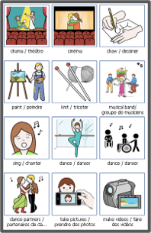
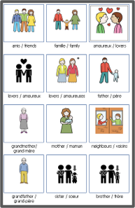
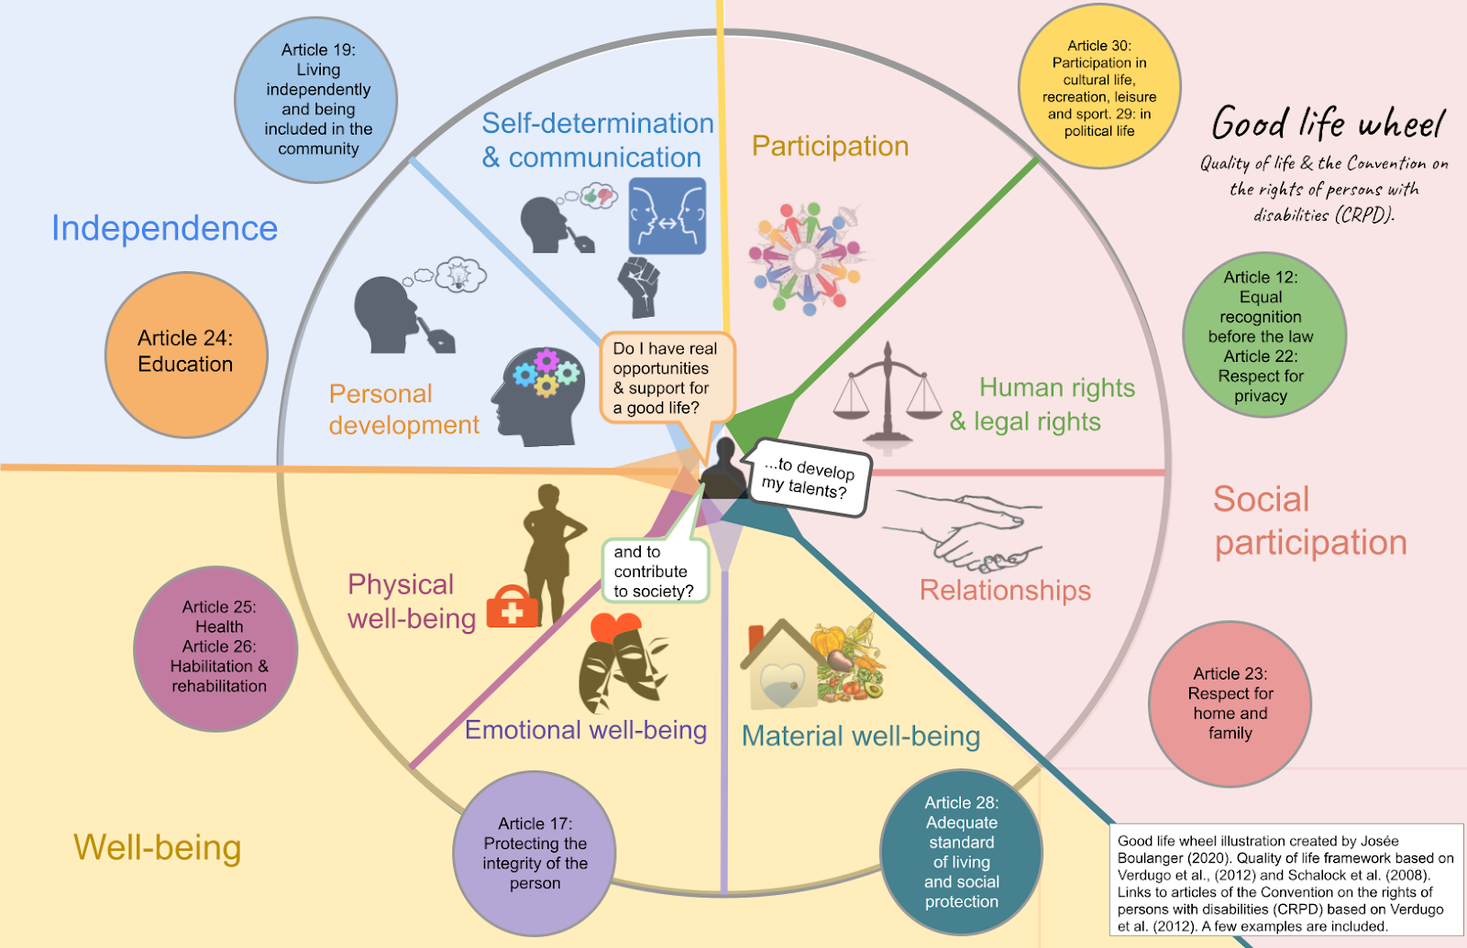
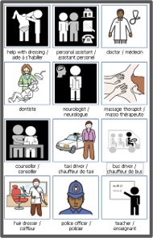
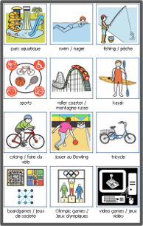
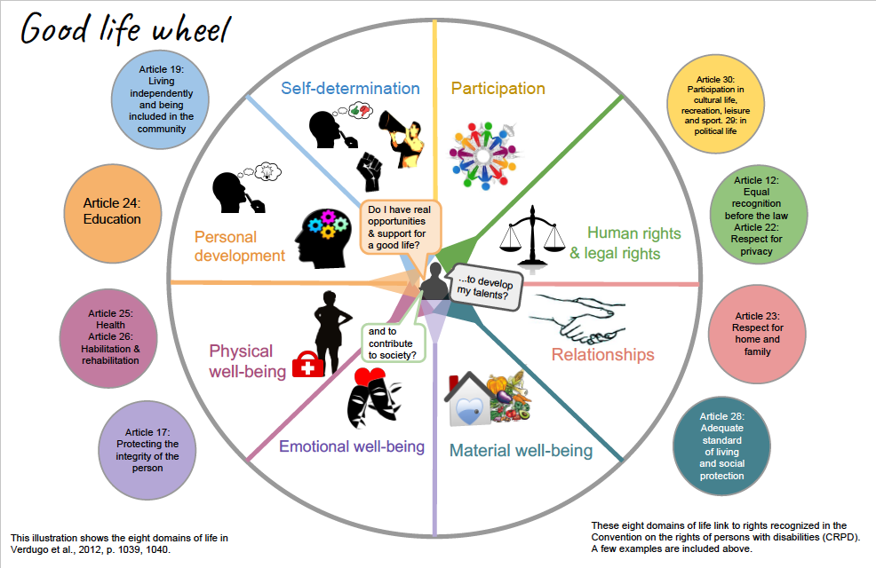
Maggie's video vignettes link to Social participation and Independence.
7. Facilitating thinking and talking about a good life
Notes:
I apologize for the busy-ness of this slide. These are visual supports I made to help with thinking and talking about a good life.
At the center is what I called the Good life wheel. It illustrates the eight quality of life domains linked to articles of the Convention on the rights of persons with disabilities (CRPD). The illustration was inspired from a table in an article by Verdugo et al. (2012).
To the left and to the right, are examples of individual pictogram sheets I made to further think about each domain of life. On left are pictograms related to participation. On the right, are pictograms related to different types of relationships. I tried to include as many examples as possible, they proved to be an excellent tool. They simple to make using a free online website called Pictoselector managed by a father.
This is how the quality of life framework and the CRPD articles served as springboards to explore a good life with participants.

Slide 8
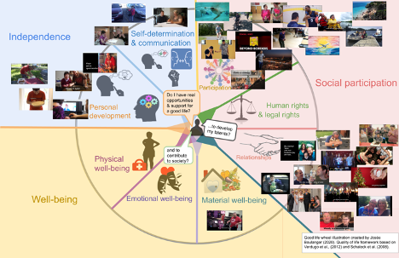
8. Results of exploring a good life using audio/visual methods
Notes:
Participants played a directorial role in the production of the video vignettes. Supporters and I assisted by taking pictures, recording video and searching for images. I assembled the video and images using video editing software. Participants had the opportunity on many occasions to watch the vignettes and request changes.
Following this collaborative and back and forth process, we produced a total of 34 video vignettes revealing that participants value participation in creative activities such as dance, painting, digital art, writing, drawing, baking and sports like soccer, gymnastics, basketball, swimming, rowing and cycling.
The video vignettes also showed that relationships were key to a good life. Participants mentioned family, friends, support workers, an intimate relationship and a pet as important to their good life.
There were important relational aspects to participation in the activities appearing in the video vignettes and important relational aspects to participating in the research process.
The results show that participation is key to a good life but that relationships make it possible and meaningful.
In many vignettes, participants communicate that taking part in activities they enjoy with people they care about is often as important as the activity itself.
Outside the frame of the video vignettes, participation in sports and creative activities was facilitated by relationships with family members, friends and support workers who assisted with tasks such as researching opportunities, organizing or providing transportation, communicating with services, providing direct assistance, managing individualized Passport funding using the funds to pay for activities and/or supplementing with their own funds if they could.
Academic literature (Fulford & Cobigo, 2018, Ignagni et al., 2016, Johnson et al., 2010, Gladstone, 2014,) and publications by families (Community Living British Columbia, 2011, Etmanski, 2000) and self-advocates (Bloomfield, 2010) supports the importance of relationships. A recent video publication by Respecting Rights (2021) self-advocates reaffirms the importance of having the freedom to choose and being supported in their relationships. These relationships are considered a “primary vehicle” for inclusion (Lord & Hutchison, 2007, p. 13).

Slide 9
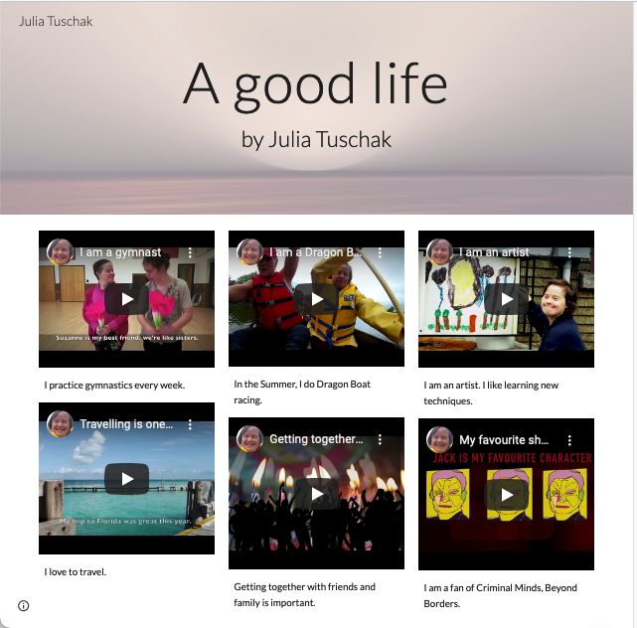
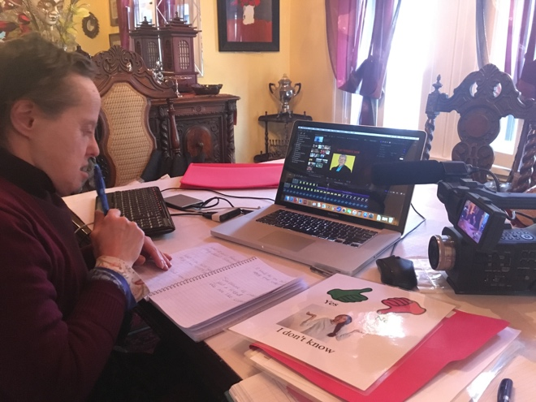
9. Results
Julia’s video vignettes
https://sites.google.com/view/julia-tuschak/home
Notes:
Each participant had between 5 and 8 video vignettes.
I thought you might be curious to watch a vignette so let’s have a look at Julia's video vignette about rowing which is related to participation.
We see that Julia loves the competition and the speed of rowing but also the company of her sister and having fun with her teammates.

Slide 10
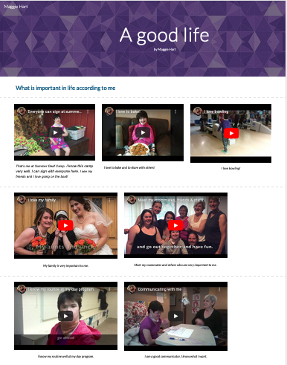
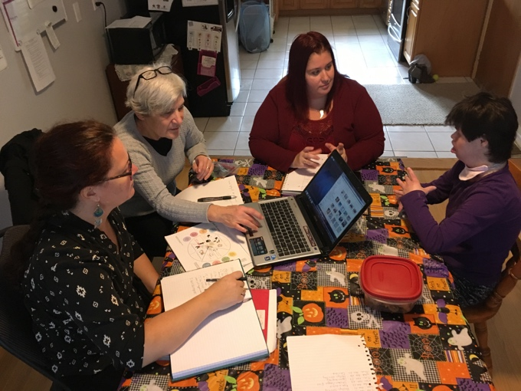
10. Results Maggie’s video vignettes https://sites.google.com/view/maggie-hart/accueil
Notes:
Now, let’s watch a video vignette where Maggie is having short conversation with her mother. This vignette relates to self-determination and communication.
In the vignette we see that when the person communicating with Maggie knows her communication style well, Maggie easily asserts herself. Her other vignettes focus on participation and relationships.

Slide 11
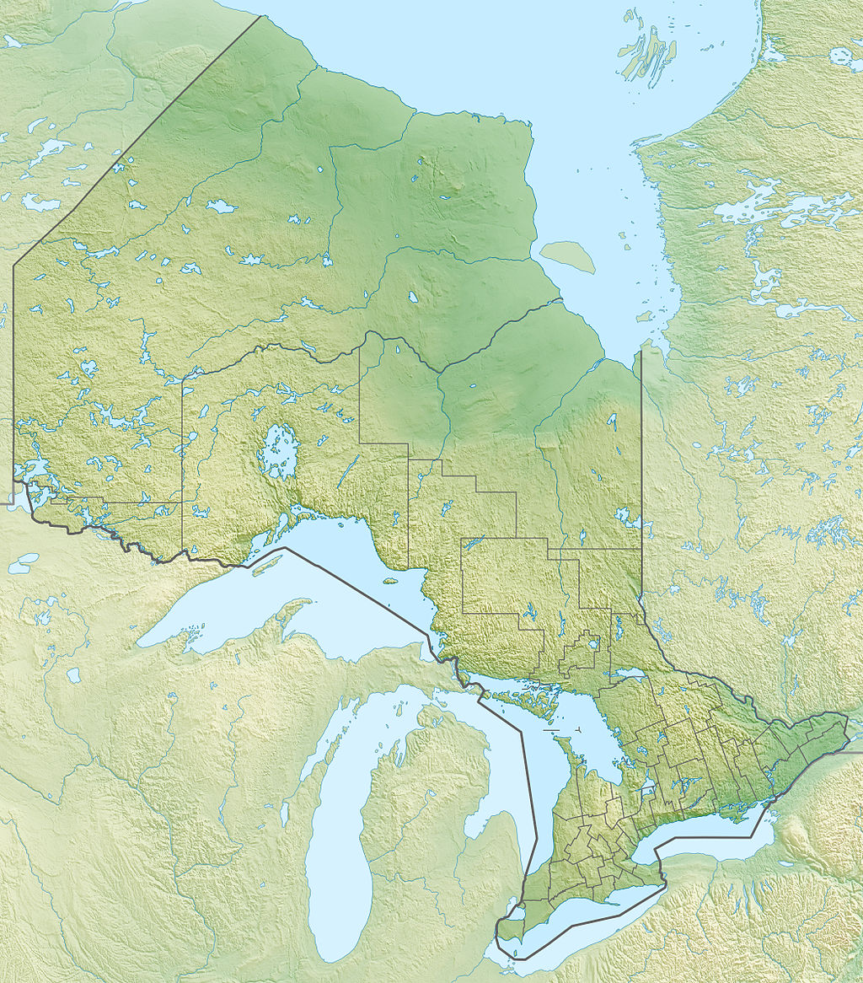



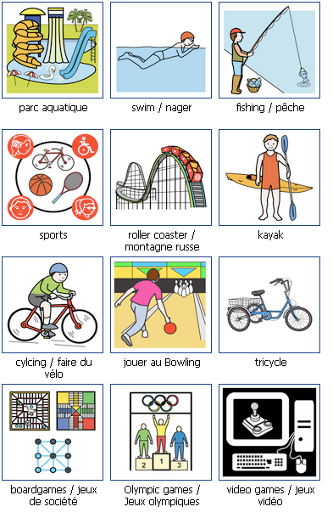
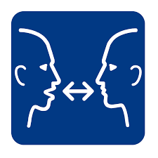

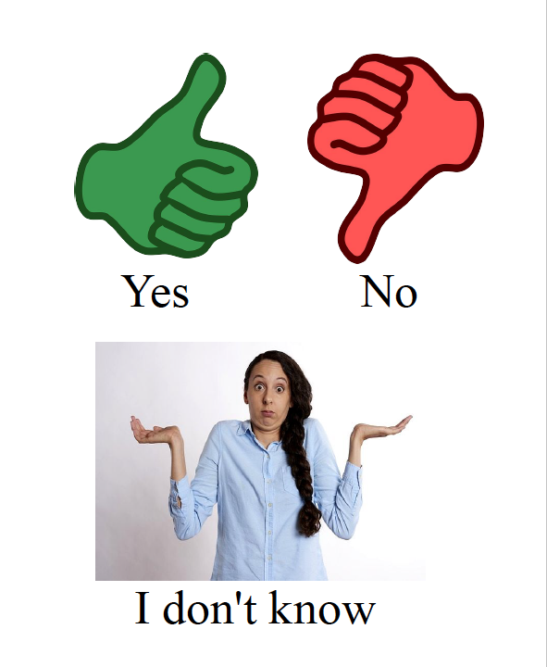
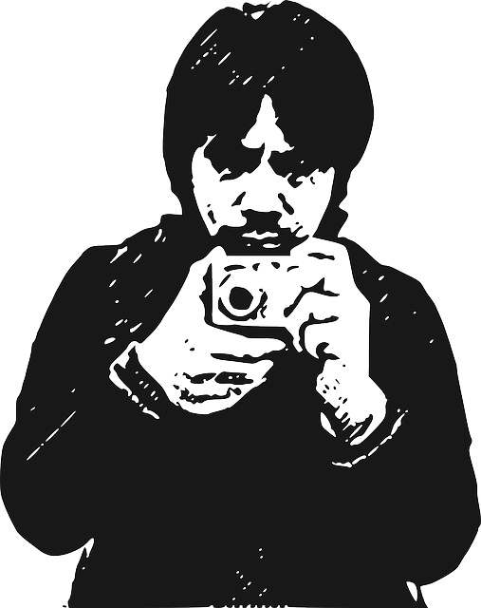
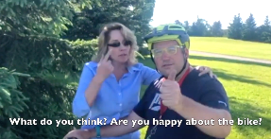
11. What does this research suggest for practice and policy?
Designing for participation
Direct participation in policymaking
Regional Peer Advocacy Committees/Partnership Tables/Citizens’ Councils?
Committee/
Table/Council?
Committee/
Table/Council?
Committee/
Table/Council?
Committee/
Table/Council?
Committee/
Table/Council?
Committee/
Table/Council?
Committee/
Table/Council?
Committee/
Table/Council?
Notes:
Slide 11: What do the result suggest for practice and policy?
The results show that participation and autonomy are key to a good life and that relationships play a key role in both. I come back to relationships in the next slide.
For practice
The findings of this research, including the advocacy efforts of the past, indicate the need to continue exploring methodological approaches that facilitate the participation of people with intellectual disabilities and others who face barriers to communication and cognition in research.
More research should be conducted with PLWID to explore the kinds of relationships people want and how to better facilitate opportunities for such relationships, how to protect existing relationships.
As researchers, we must pay attention to designing studies that facilitate meaningful participation in research for all, including and perhaps especially people who face significant barriers to cognition and communication.
As practitioners in research, health, education and social services we must be creative with communication supports, there is lots that can be done to facilitate communication and understanding. Free resources exist but you can also create your own like I did to explore a good life. Supporters play an important role in facilitating communication but as practitioners our goal should be to interact directly with participants, patients or service-users.
For policy
There is an urgent need to co-design structures and processes to facilitate the direct participation of PLWID and families in the development of policy and legislation. This includes policy in education, in research, service provider policies among many others.
Legislation should reflect a relational or interactional understanding of intellectual and developmental disability. The Social Inclusion Act, 2008 must also update its definition of developmental disability to reflect the real environmental barriers people face to cognition, communication and adaptation.
Policies that support and promote cognitive and communicative access tailored to the individual is necessary for meaningful participation in all aspects of life. This includes access to sufficient human personal assistance.
Participation, individual choice, independence, rights well-being are recognized in the Social Inclusion Act, 2008 but very little guidance and tools are provided to put them into practice.
There must be a discussion about what these words mean to people with intellectual and developmental disabilities and which other words should be there. This research, among others, suggests that relationships are important.

Slide 12



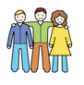







12. Centering relationships
The right to autonomy
Article 3
The right to
participation in all aspects of life
Article 30
The right to education
Article 24
Intimate
relationships,
friendships and
marriage - Article 23
Relationships
The right to expression,
opinion and information
Article 21
The right to personal mobility
Article 20
Articles of the Convention on the rights of persons with disabilities (CRPD) that support the development and/or maintenance of relationships.
The right to live independently and be included in the community
Article 19
The right to privacy
Article 22
An adequate
standard of living
and social protection
Article 28
Notes:
Slide 12: So, what if we wanted policy to focus on and support relationships?
Where could we begin? One tool that could help is the Convention on the Rights of Persons with Disabilities. Although the Convention only refers to relationships specifically in Article 23 - Respect for home and the family many other rights protect and promote relationships which, as we saw, are key to other good things considered important like participant and self-determination. Based on this research and the literature, the following are 9 rights that facilitate and protect relationships:
Article 3 - General Principles (Respect for inherent dignity and individual autonomy)
Article 19 - Living independently and being included in the community (Access to personal assistance and choice about where you want to live and with whom)
Article 20 - Personal mobility
Article 21 - Freedom of expression and opinion, and access to information (all accessible means, modes and formats of communication)
Article 22 - Respect for privacy
Article 23 - Respect for home and the family (respect for all types of relationships)
Article 24 – Education
Article 28 - Adequate standard of living and social protection
Article 30 - Participation in cultural life, recreation, leisure and sport
Some of these rights can be protected through the Social Inclusion Act, 2008, others would require changes in other laws. The Convention is a useful guide for policy makers, people with intellectual disabilities and their allies to think and work together towards systemic change.
Conclusion:
Just as people labelled with an intellectual disability have played leadership roles in creating the Convention, especially Article 12 - Equal recognition before the law, in the Eve Decision about forced sterilization, in Ontario's 1992 Advocacy Act, they have much to contribute about cognitive and communication accommodations that can benefit others who face similar barriers and for the betterment of society as a whole.

